Slide 1
ASPiH - AGM 22nd March 2023
@ASPiHUK
Notes:
Membership & Finance reports 2021-2022
Question and answer session – please put questions in the chat or save them for later

Slide 2
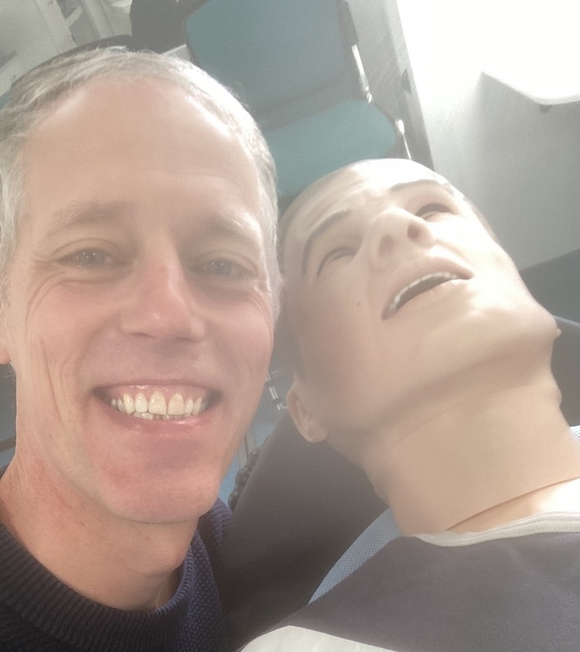
A word from Immediate Past President
Notes:
Dr Michael Moneypenny (President of ASPiH 2020 – 2022)
It has been a privilege to have been the President of ASPiH for the past couple of years but in November 2022 the time came to step down and hand over the baton to Colette Laws-Chapman who I have no doubt that with her passion and enthusiasm will do a fantastic job in her new role.
We have seen our membership of the Association grow and as an Exec we have ensured that our member benefits have remained current and of interest to our members, we introduced many events including the monthly Journal Club, Twitter Chats and Webinars which continue to be well received and attended.
It has been our pleasure to accredit many organisations and see the accreditation visit move to online, we have congratulated organisations from the UK, including Bristol & Weston-super-mare and internationally, including the Hong Kong School of Nursing. The individual accreditations continue to grow and we have accredited more members over the past year!
ASPiH are proud to be accredited to award Science Council Recognition to the technical community and this is an area we continue to build on as an organisation.
I am excited for the future ahead as we collaborate, network and learn from our wonderful simulation community!
I would like to finish off by saying thank you to all the Executive Members who work tirelessly to ensure we continue to support simulation-based practice in all its guises, and to all of you, the ASPiH members, for working every day to help the lives and wellbeing of health and care staff as well as the people those staff look after.

Slide 3
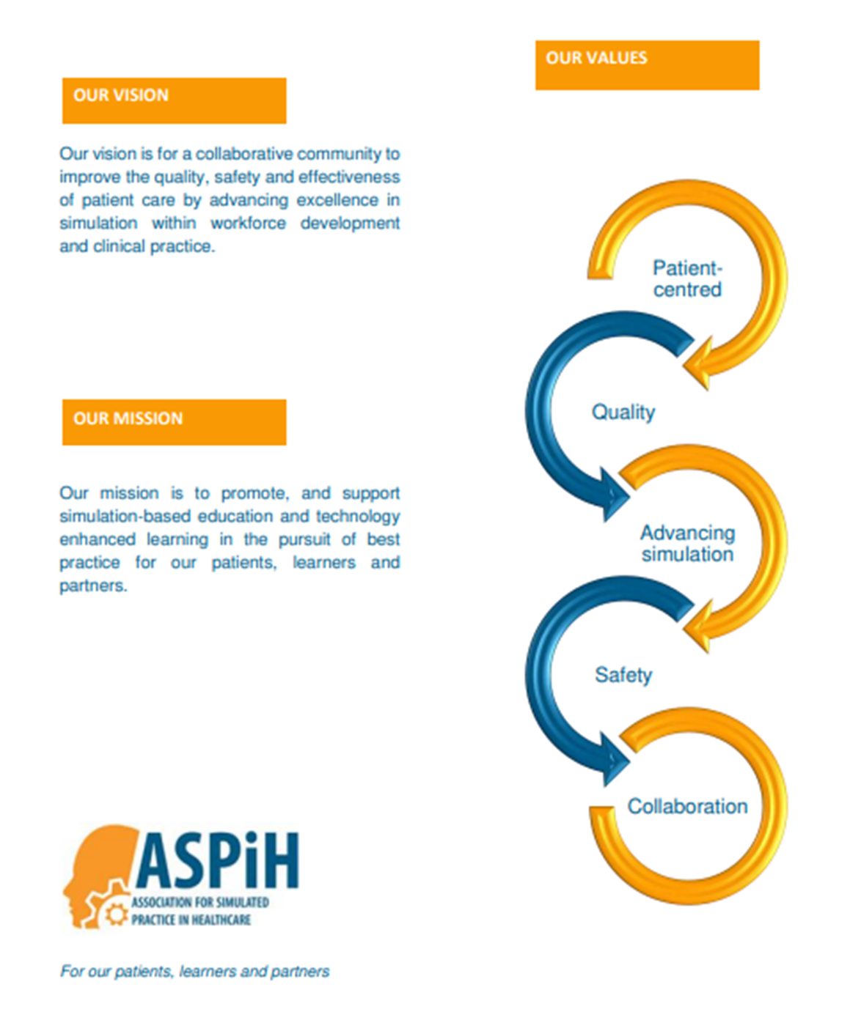
Our Values, Vision & Mission

Slide 4
ASPiH Executive Committee
Colette Laws-Chapman | President
Michael Moneypenny | Immediate Past President
Mike Morrow | Treasurer
Andy Buttery | Executive Committee Member
Guillaume Alinier | Executive Committee Member
Karen Reynolds | Executive Committee Member
Sharon Wheldon | Executive Committee Member
Paul O’Connor | Executive Committee Member
Carla Sa Couto | Executive Committee Member
Cristina Diaz Navarro | Executive Committee Member
Emily Browne | Executive Committee Member
Ratna Makker | Executive Committee Member
Marian Traynor | Executive Committee Member
Robyn Stiger | Executive Committee Member
Lorraine Whatley | Executive Committee Member
Kevin Stirling | Executive Committee Member
Jane Roome | Executive Committee Member
Naomi Shiner | Executive Committee Member
Simulation Technologist (TBC) | Executive Committee Member

Slide 5
Membership Activity
Monthly Webinars, Journal club and Twitter chats
Topics selected from membership survey including; Debriefing, Human Factors, Wellbeing & Transformational Simulation.
Communication
ASPiH eNews and social media updates continue
We would love to hear your news – send in items to us
Linked in & Facebook refresh
Special Interest Groups
Active groups, new groups, conference workshops
Accreditation
6 members supported to achieve Individual Accreditation
4 in progress
5 organisations awarded Organisational Accreditation status
3 in progress
1 programme awarded Programme Accreditation
6 member technicians were supported to achieve the Science Council Award

Slide 6
Membership Activity – Accreditation Awards
Hong Kong University | Organisation
Bradford Teaching Hospitals | Organisation
Toby Garrity | Individual
Josh Bachra | Individual
OxStar | Organisation
Helen Henderson | Individual
Debbie Suggit | Individual
Great Ormond Street Hospital | Organisation
Miroslava Slavska | Programme
Emma Smith | Individual
Derek Chebsey | Individual
Debbie Thackray | Individual

Slide 7
Membership Activity –
Science Council Accreditation Awards
RSci TECH | Dimitar | Bakalov
RSci TECH | Andrew | Griffiths
RSci TECH | Joe | Williams
RSci TECH | James | Ham
RSci TECH | Lyndsey | Bellamy
RSci TECH | Jake | Brammer

Slide 8
Membership Activity
Inaugural National Sim Tech Day 15th September 2021 – to celebrate the innovative work of our technicians
Sim Tech Day 2023 is in planning stages
Job Vacancy & course advertising
Free access to the IRIS platform
Scoping further membership benefits in 2023 …………

Slide 9
International Journal of Healthcare Simulation (IJoHS) – Advances in Theory & Practice
IJoHS - simulation-based digital journal; joint ownership with Society for Healthcare Simulation (SHS) and Adi Health+Wellness
- online journal open access + platform to submit work for publication
Official journal of ASPiH, Society for Healthcare Simulation, India and Pan Asia Simulation Society in Healthcare
Prof. Debra Nestel, Editor-in-Chief
ASPiH EC on Operational Board
Globally renowned Editorial Board inc
Conference supplement produced with individual DOI’s for abstracts selected by the editorial board
For more information, please visit https://www.ijohs.com/

Slide 10
Finance Update

Slide 11
Finance Update
Mike Morrow
ASPiH Treasurer
21st March 2023

Slide 12
Financial Year 2022
FYE 31.12.22 *
Turnover £300,082
Cost of sales £211,401
Admin expenses £8,893
Profit for FYE2022 £79,788
* 2022 figures are current best estimates and remain subject to audit and accountancy review

Slide 13
Financial Year 2022
Year ended 31st Dec
2022
2021
2020
£84,487
£66,997
£10,863
£6,627
£82,868
£69,323
£7,673
£5,872
Turnover £300,082
Cost of sales £211,401
Admin expenses £8,893
Profit for FYE2022 £79,788
* 2022 figures are current best estimates and remain subject to audit and accountancy review

Slide 14
Income
 | 2022 | 2021 | 2020
Membership | 38,895 | 23,284 | 54,813
Conference | 175,156 | 48,964 | 17,492
Accreditation | 300 | 210 | 30
Workshops/courses | 3,007 | 0 | -50
Sponsors | 82,649 | 8,775 | 4,750
Miscellaneous | 0 | 3,254 | 5,733
 | 300,082 | 84,487 | 82,868

Slide 15
Cost of Sales
 | 2022 | 2021 | 2020
Conference | -126,585 | -6,774 | -11,300
EBS | -33,659 | -33,000 | -32,213
General Administration | -8,893 | -7,706 | --6,060
ASPiH Services | -13,547 | -14,353 | -8,650
Journal (IJoHS and BMJ STEL) | -20,000 | -23,092 | -18,354
Exec committee | -834 | 0 | 0
Miscellaneous | -16,776 | -2,393 | -419
COS | -220,294 | -77,860 | -76,996

Slide 16
Capital & Reserves
ASPiH Current Accounts (on 31st December)
2022 | 2021 | 2020
105,151 | 71,827 | 59,797

Slide 17
HMRC VAT
Feb 2021
HMRC contacted EBS as part of regular Compliance checking.
Conference and membership were incorrectly separated as a different supply. Should have been a partial exemption only.
ASPiH paying too much VAT on Conference income and not enough on Membership income.
Potentially significant tax liability of up to £45k (plus 30% penalty) identified.
June 2022
HMRC accept ASPiH’s revised VAT calculations:
VAT should be charged on Membership
VAT should be charged on Sponsorship income
Vat should not be charged on Conference Delegate fees

Slide 18
HMRC VAT
June 2022
VAT liability of £11,151
Penalty reduced to 15% due to Association’s genuine efforts to correct previous errors
BUT … all penalties suspended as long as all calculations for partial exemption are made and submitted with quarterly VAT returns
July 2022
£11,151 outstanding VAT paid to HMRC
£12,696 professional fees for specialist VAT advice

Slide 19
EBS Services Contract Dec 2020 - Dec 2023
Executive Business Support (EBS)provide the following services.
Currently £2,750 pcm
Accounts
Provide bookkeeping services
Raise and process invoices
Provide monthly finance management reports
Bank reconciliation
Credit control
Conference
Delivery of annual conference, either a physical, virtual or hybrid conference.
Contract due for review December 2023
Directors to meet in April to discuss EBS contract going forward
Association support contract to be put out to tender during 2023.
Aim to have new contract in place for 2024

Slide 20
International Journal of Healthcare Simulation (IJoHS)
Bespoke Bronze package - £20,000/year (minimum of 2-year contract term)
Opportunity to author and publish 12 articles per year in IJoHS (3-4 issues per year)
One issue of supplement per year
Dedicated Simulation professional's community platform through Member Portal
Member Corporate Profile on IJoHS's webpage
All-year access to IJoHS and its archived issues

Slide 21
Outlook for 2024
Membership doing well but requires ongoing vigilance.
Renegotiated EBS contract has been generally successful.
VAT issue complex but resolved professionally and satisfactorily.
General expenses under control.
Birmingham Conference particularly successful.
Need to protect our existing funds and invest for the future.

Slide 22
CALL FOR ABSTRACTS NOW OPEN – DEADLINE 30TH April
Keynote speakers to be
announced soon!
Sustainable Simulation
Registration opening Soon!
Pre-conference workshops – 6th November
Grab your bucket and spade to
JOIN US IN BRIGHTON!
Poster presentations
Workshops
Sponsored symposia
Oral Presentations
Exhibition Hall
Immersive escape room
Networking
Gala Dinner
Sponsored fun run
Wellbeing sessions
Monday 6th - Wednesday 8th November 2023
Hilton Brighton Metropole
We are working with Visit Brighton who are providing lots of delegate discounts and deals!
Why not make a trip out of it!
Visit https://www.visitbrighton.com/
Follow us on Twitter & Linkedin
@ASPiHUK
#ASPIH2023
Visit www.aspihconference.co.uk for more information

Slide 23
Looking to the future…
New edition of ASPiH Standards
Revised Accreditation review process
Member Discussion Forums on the members area of the ASPiH Website
Lunchtime online Events + Evening to increase accessibility
Expansion of SIG activity
Online Meta Debrief club for members via the SIG
Members contributions for the Newsletter and Website
Annual National Sim Tech Day #SimTechDay 15th September
Members - Have your Say sessions – tell us what you want from your ASPiH Membership

Slide 24
Open for Questions

