Slide 1
How to write a good abstract?
By Guillaume Alinier & Andy Buttery
ASPiH Executive Committee members
Presenters’ affiliations…
Conflict of interest: None

Slide 2
CALL FOR ABSTRACTS OPEN – DEADLINE 30TH April
Key Note Speaker Announcement!
First of our four key note speakers, Dr Connie Wiskin will be delivering a talk on sustainability and evolution of human simulation in healthcare education.
Sustainable Simulation
Registration opening Soon!
Grab your bucket and spade to
JOIN US IN BRIGHTON!
Poster presentations
Workshops
Sponsored symposia
Oral Presentations
Exhibition Hall
Immersive escape room
Networking
Gala Dinner
Sponsored fun run
Wellbeing sessions
Monday 6th - Wednesday 8th November 2023
Hilton Brighton Metropole
We are working with Visit Brighton who are providing lots of delegate discounts and deals!
Why not make a trip out of it!
Visit https://www.visitbrighton.com/
Pre-conference workshops – 6th November
@ASPiHUK
#ASPIH2023
Visit www.aspihconference.co.uk for more information

Slide 3
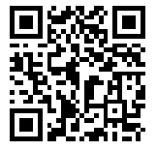
Why do we write an abstract?
Share findings about a study
Summarise background research you have done on a topic
Share ideas
Present your work to get feedback
Run a workshop
Engage with others on your topic
Get it published in a journal
Get institutional support to attend a conference
#ASPIH2023
@ASPiHUK
@g_Alinier
@andibuttri
For abstract guidelines and submission:

Slide 4
What is a good abstract?
It follows the stipulated format for the type of submission:
Poster
Oral communication
Workshop
It is Complete/Concise/Clear/Cohesive
It responds to Why/Who/Where/When/How/So what?
It provides a clear picture of your overall project/idea
#ASPIH2023
@ASPiHUK
@g_Alinier
@andibuttri
For abstract guidelines and submission:

Slide 5
Why should you comply to the “guidelines”?
They are in fact key requirements.
It facilitates the review process and “marking” of the abstracts.
It significantly increases your chances of acceptance.
#ASPIH2023
@ASPiHUK
@g_Alinier
@andibuttri
For abstract guidelines and submission:

Slide 6
Key recommendations
Make good use of the word limit to say what you need.
Do not write in the future tense.
Adhere to the “guidelines” as “strict requirements”.
Take advantage of adding figures, tables, and references if allowed.
Do not refer to the “abstract”, “presentation”, or “poster” within the abstract text.
Get it proofread by someone who knows nothing about the work you are submitting.
#ASPIH2023
@ASPiHUK
@g_Alinier
@andibuttri
For abstract guidelines and submission:

Slide 7
#ASPIH2023
@ASPiHUK
@g_Alinier
@andibuttri
For abstract guidelines and submission:

Slide 8
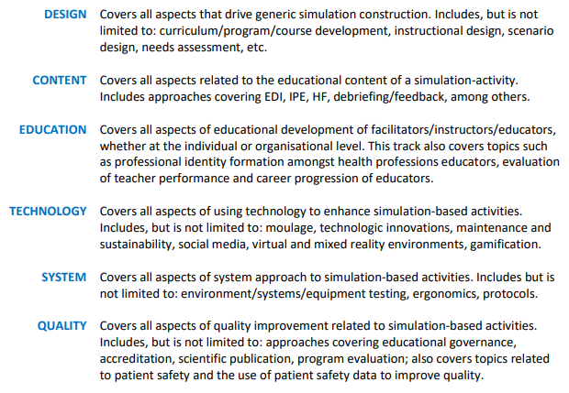
Submission topics
#ASPIH2023
@ASPiHUK
@g_Alinier
@andibuttri
For abstract guidelines and submission:

Slide 9
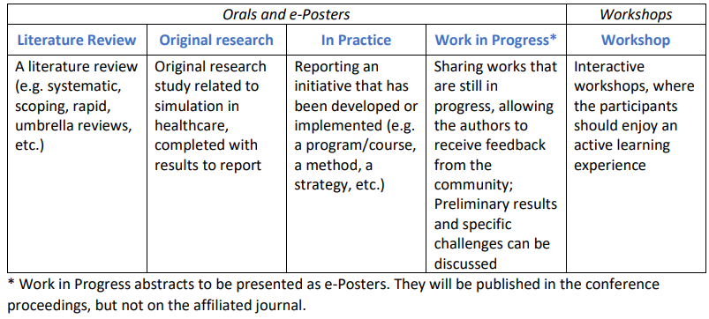
Submission types
@ASPiHUK
#ASPIH2023
For abstract guidelines and submission:

Slide 10
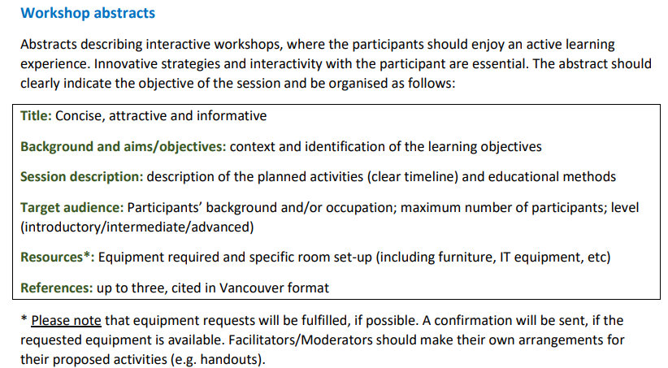
For workshops
@ASPiHUK
#ASPIH2023
For abstract guidelines and submission:

Slide 11
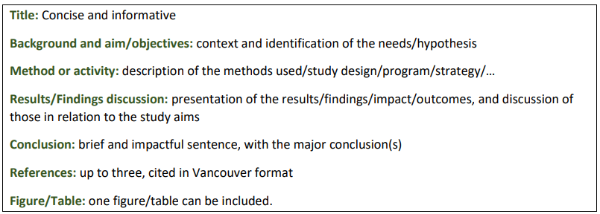
For poster & oral presentations
#ASPIH2023
@ASPiHUK
@g_Alinier
@andibuttri
For abstract guidelines and submission:

Slide 12
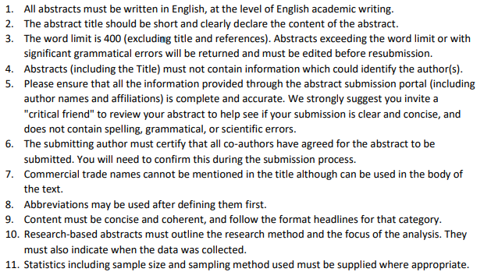
The ASPiH Abstract Guidelines
#ASPIH2023
@ASPiHUK
@g_Alinier
@andibuttri
For abstract guidelines and submission:

Slide 13
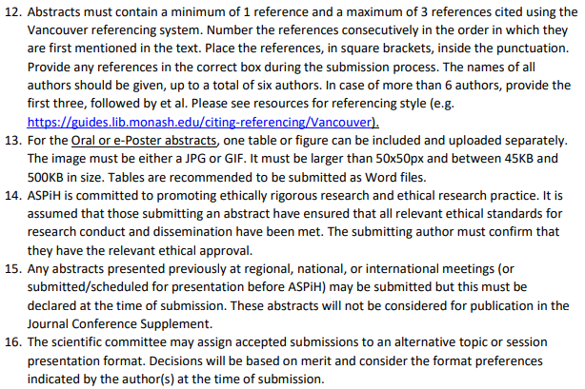
The ASPiH Abstract Guidelines
#ASPIH2023
@ASPiHUK
@g_Alinier
@andibuttri
For abstract guidelines and submission:

Slide 14
Are you ready?
Any question?
G.Alinier@herts.ac.uk
Andy.Buttery@canterbury.ac.uk
#ASPIH2023
@ASPiHUK
@g_Alinier
@andibuttri
For abstract guidelines and submission:

Slide 15
Bibliography/Resources
https://aspihconference.co.uk/wp-content/uploads/2023/02/FINAL-Abstract-Submission-Guidelines-2023.pdf
https://www.physio-pedia.com/Writing_a_Conference_Abstract
https://blogs.lse.ac.uk/impactofsocialsciences/2015/01/27/how-to-write-a-killer-conference-abstract/
https://blogs.lse.ac.uk/impactofsocialsciences/2011/06/20/essential-guide-writing-good-abstracts/
ASPIH 2021 published abstracts: https://www.ijohs.com/journals/international-journal-of-healthcare-simulation/volume/1/issue/Supplement%201#
ASPIH 2022 published abstracts: https://www.ijohs.com/journals/international-journal-of-healthcare-simulation/volume/2/issue/Supplement%201#
#ASPIH2023
@ASPiHUK
@g_Alinier
@andibuttri
For abstract guidelines and submission:

